Slide 1

Automated Newspaper Summarization & Analysis
OCR, NLP & Text-to-Speech with Military Flair
Team Name: Ai Bois
Date: 13/03/2025

Slide 2
Problem Statement
Newspapers contain large amounts of data, making manual summarization tedious.
Traditional methods lack efficiency and sentiment insights.
Goal: Automate text extraction, summarization, sentiment analysis, and audio conversion.

Slide 3
Solution Overview
Step 1: OCR-based text extraction
Step 2: NLP-based summarization (Sumy)
Step 3: Sentiment analysis (NLTK)
Step 4: Keyword extraction (CountVectorizer)
Step 5: Military-style voice enhancement & text-to-speech (pyttsx3)

Slide 4

Insert a flowchart here showing:
- OCR → Cleaning → Summarization → Sentiment Analysis → Audio Conversion
- Input: Newspaper Image
- Output: Text Summary, Sentiment Report, Audio

Slide 5

Code Breakdown (Key Features)
OCR (Tesseract): Extracts text from images
Text Processing (Regex, NLP): Cleans and summarizes text
Sentiment Analysis (VADER): Determines news polarity
Keyword Extraction (CountVectorizer): Identifies key topics
TTS (pyttsx3): Converts text to speech

Slide 6

Challenges & Solutions
Challenge: Noisy images → Solution: Preprocessing with OpenCV
Challenge: OCR accuracy → Solution: Enhancing contrast & binarization
Challenge: Handling short text → Solution: Skip summarization for <10 words

Slide 7

Future Scope
Improve OCR with deep learning models (Tesseract alternative)
Support multiple languages
Create a web or mobile app for real-time processing
Integrate news API feeds

Slide 8

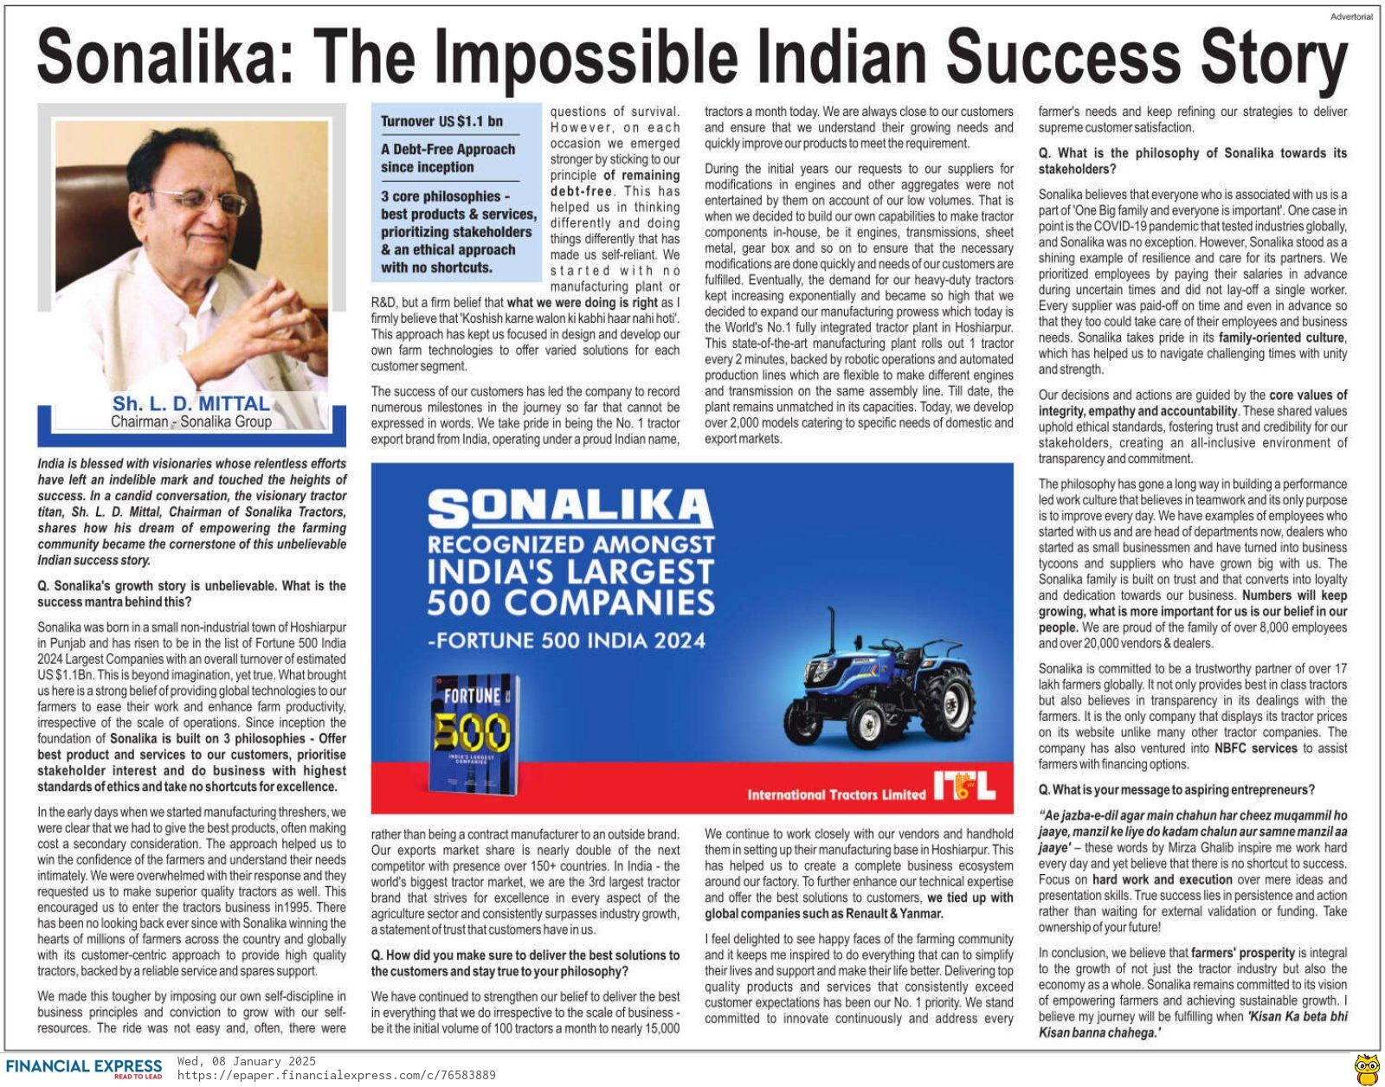
Demo & Results
I have made a Showcase of before & after of text extraction, summary, sentiment, and audio output.
Sample image used -->
Audio output link : https://github.com/Ritik050105/Hackathon/blob/main/Final%20Program/output_audio.mp3

Slide 9

Conclusion
Our system automates newspaper analysis with efficiency, sentiment insights, and military-style engagement.

Slide 10

Thank You!
GitHub Repo: https://github.com/Ritik050105/Hackathon.git

